Slide 1
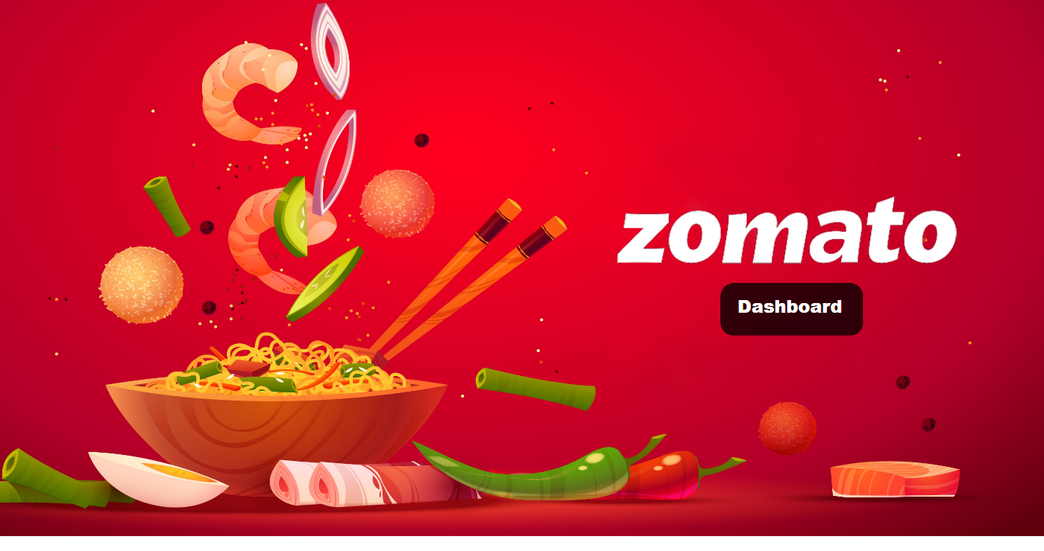
Zomato Analysis
Notes:
textbox
No alt text provided
shape
No alt text provided

Slide 2
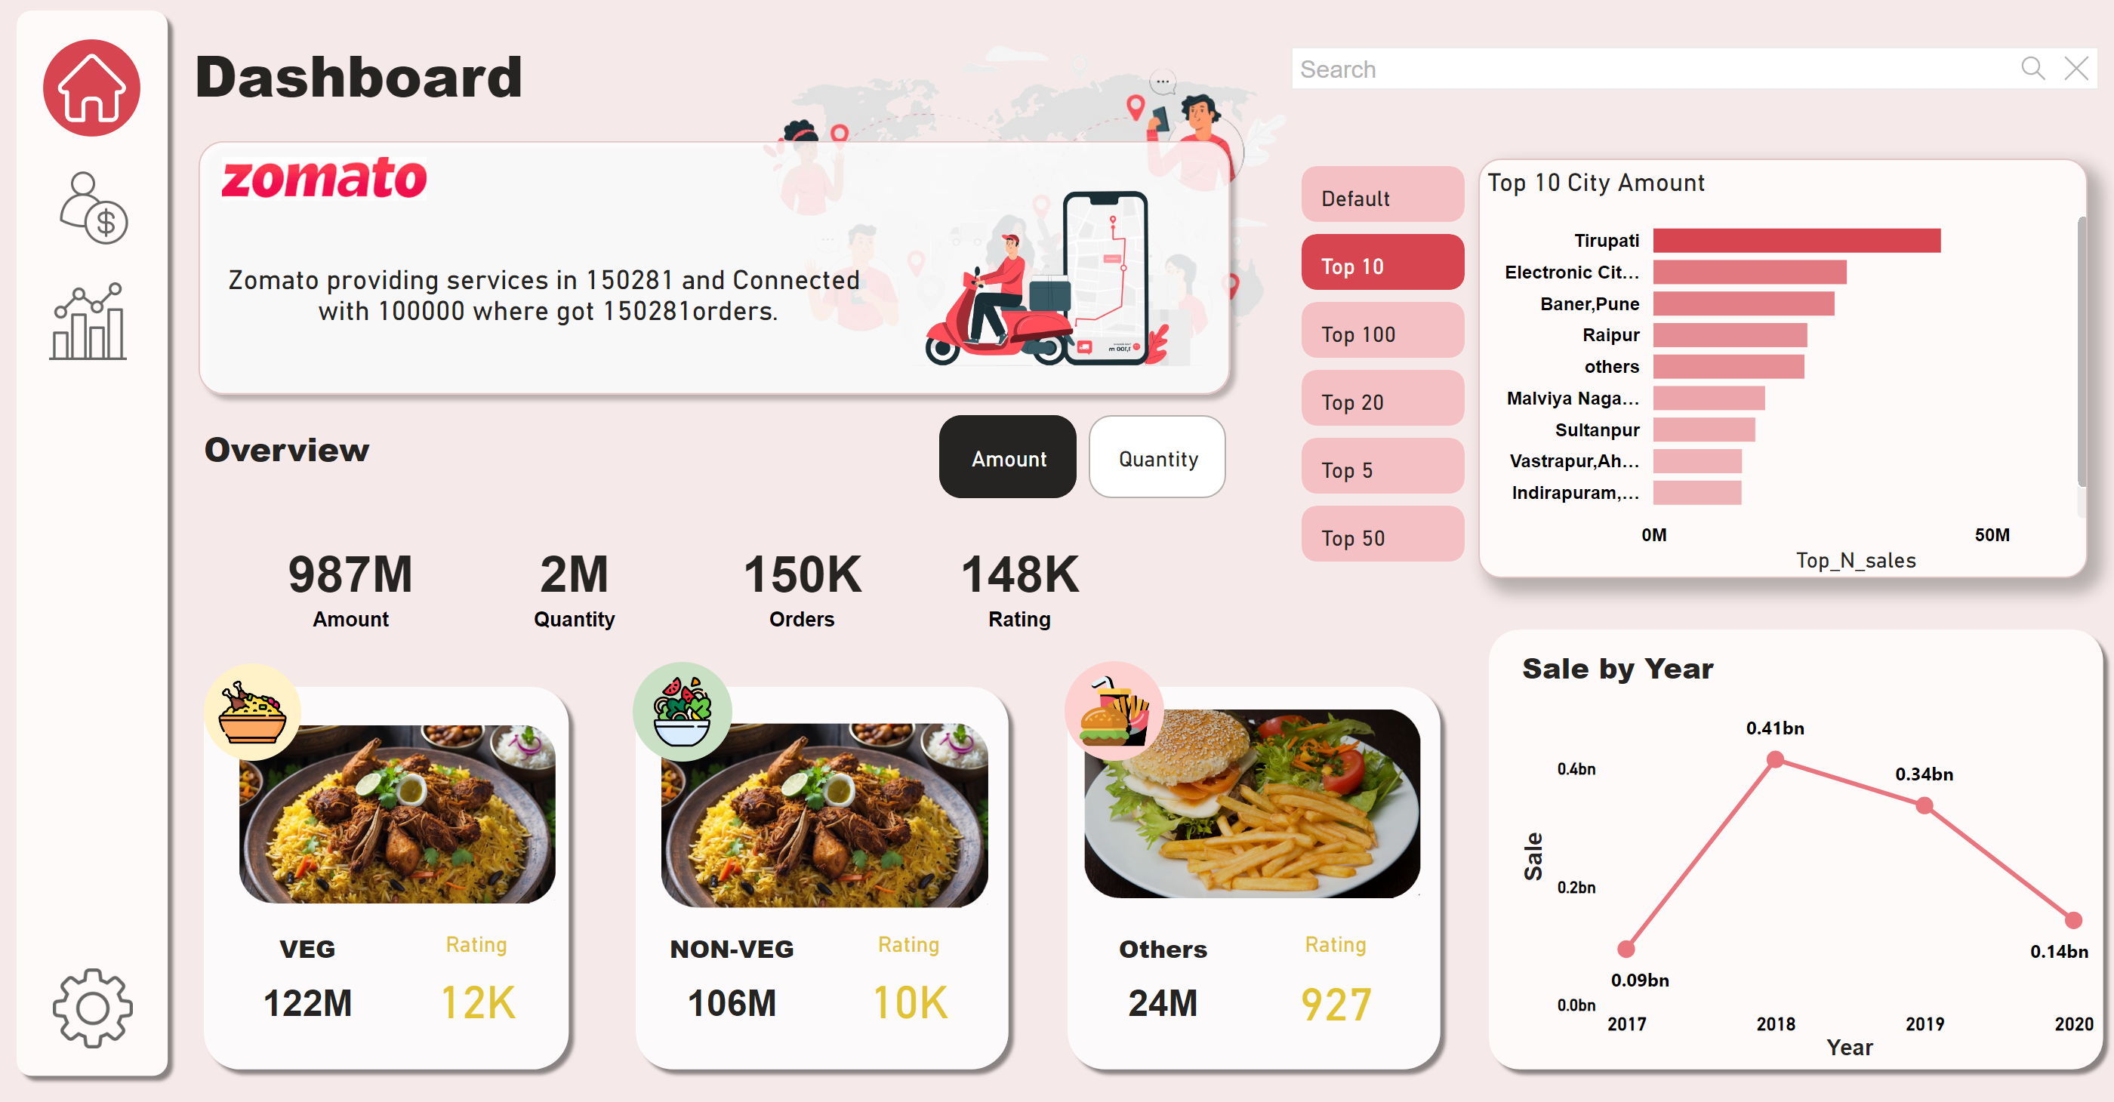
Overview
Notes:
advancedSlicerVisual
No alt text provided
Top 10 City Amount
No alt text provided
lineChart
No alt text provided
card
No alt text provided
card
No alt text provided
card
No alt text provided
card
No alt text provided
Others
No alt text provided
VEG
No alt text provided
NON-VEG
No alt text provided
City Amount
No alt text provided
Rating
No alt text provided
Rating
No alt text provided
Rating
No alt text provided
shape
No alt text provided
shape
No alt text provided
shape
No alt text provided
shape
No alt text provided
image
No alt text provided
image
No alt text provided
image
No alt text provided
image
No alt text provided
image
No alt text provided
image
No alt text provided
shape
No alt text provided
image
No alt text provided
image
No alt text provided
image
No alt text provided
image
No alt text provided
textbox
No alt text provided
image
No alt text provided
image
No alt text provided
card
No alt text provided
image
No alt text provided
textbox
No alt text provided
shape
No alt text provided
textSearchSlicerF85E2E78BE4A4D7D9F99ED75B5D71C85
No alt text provided

Slide 3
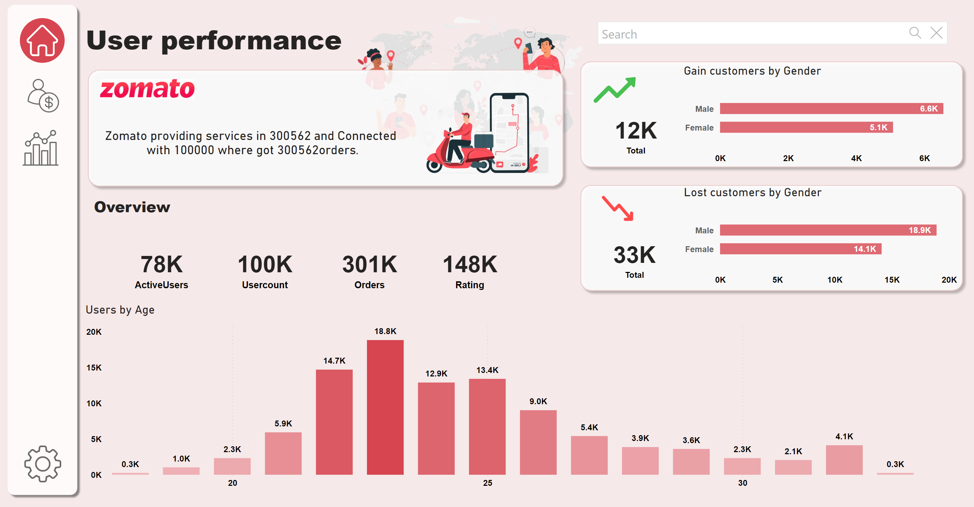
User performance
Notes:
card
No alt text provided
card
No alt text provided
card
No alt text provided
card
No alt text provided
shape
No alt text provided
shape
No alt text provided
image
No alt text provided
image
No alt text provided
image
No alt text provided
image
No alt text provided
textbox
No alt text provided
image
No alt text provided
image
No alt text provided
card
No alt text provided
image
No alt text provided
textbox
No alt text provided
Users by Age
No alt text provided
textSearchSlicerF85E2E78BE4A4D7D9F99ED75B5D71C85
No alt text provided
shape
No alt text provided
shape
No alt text provided
clusteredBarChart
No alt text provided
clusteredBarChart
No alt text provided
card
No alt text provided
card
No alt text provided
image
No alt text provided
image
No alt text provided

Slide 4
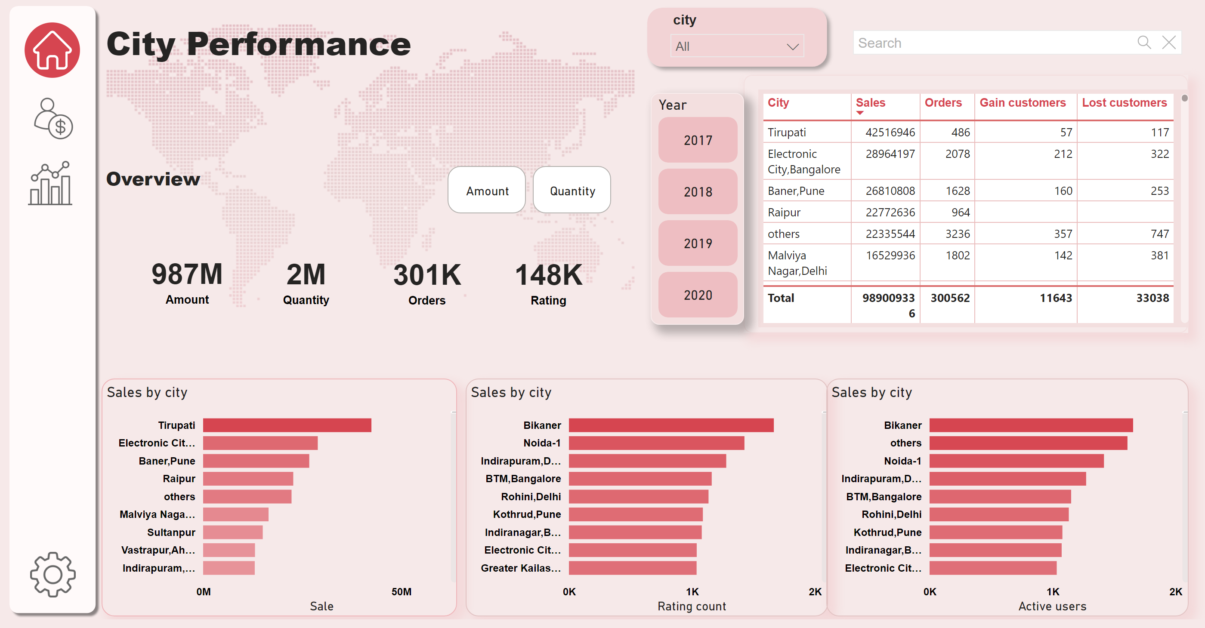
City Performance
Notes:
card
No alt text provided
card
No alt text provided
card
No alt text provided
shape
No alt text provided
image
No alt text provided
image
No alt text provided
image
No alt text provided
image
No alt text provided
textbox
No alt text provided
textbox
No alt text provided
textSearchSlicerF85E2E78BE4A4D7D9F99ED75B5D71C85
No alt text provided
image
No alt text provided
advancedSlicerVisual
No alt text provided
card
No alt text provided
Sales by city
No alt text provided
Sales by city
No alt text provided
Sales by city
No alt text provided
Sales by city
No alt text provided
shape
No alt text provided
advancedSlicerVisual
No alt text provided
slicer
No alt text provided
shape
No alt text provided

